Slide 1


Differences between
ClientBase Online and Tres

Slide 2
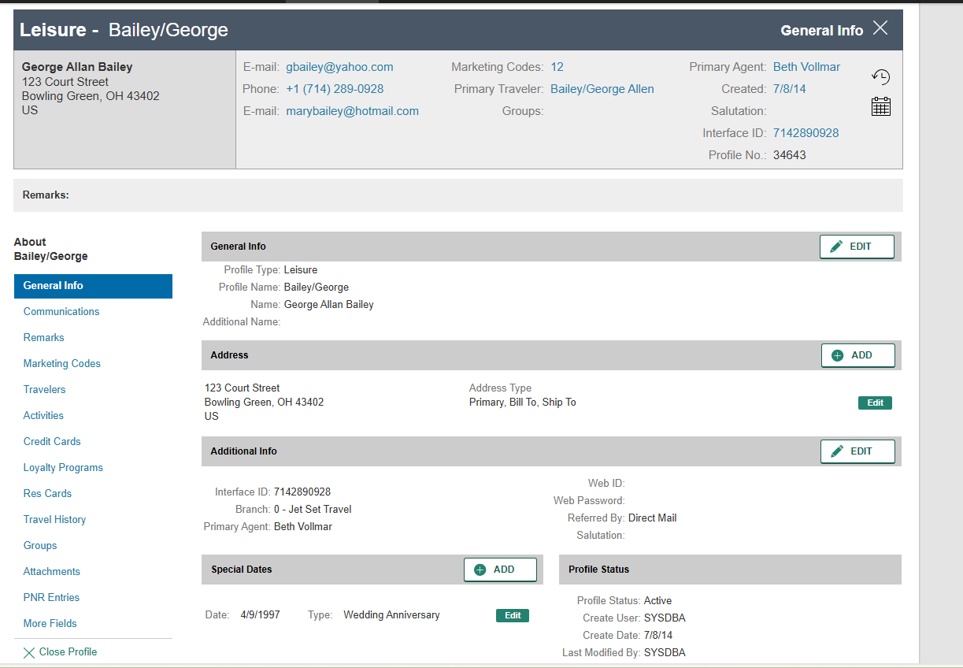
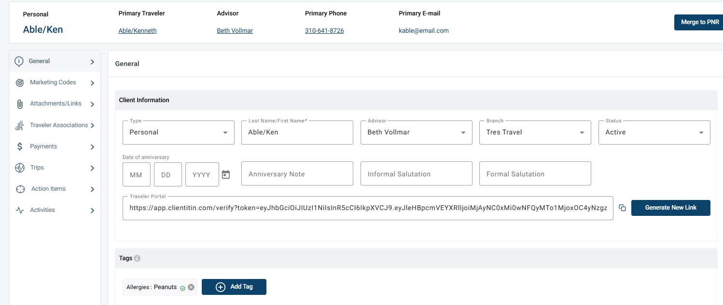
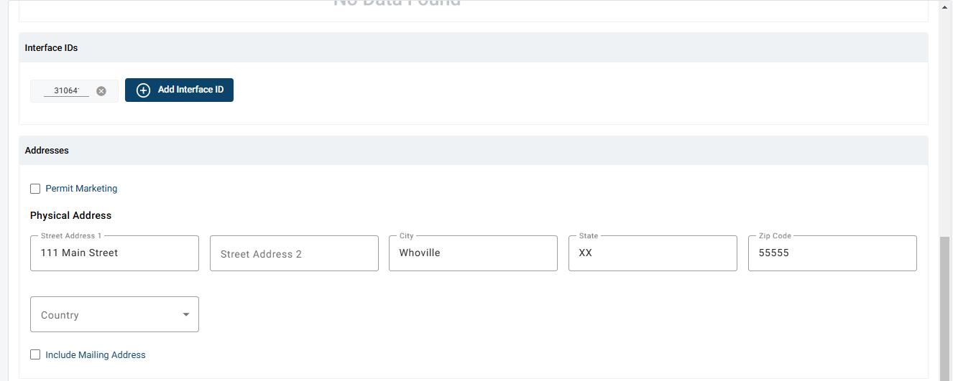
CBO Leisure Profile
Tres Client Profile
Related Article:
Clients

Slide 3
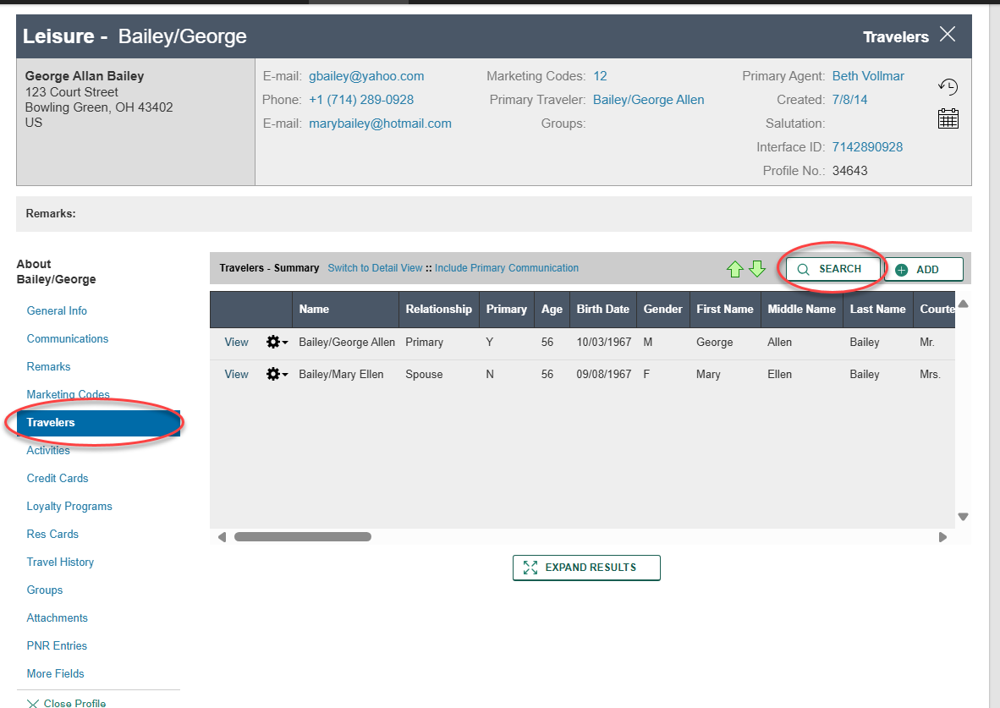
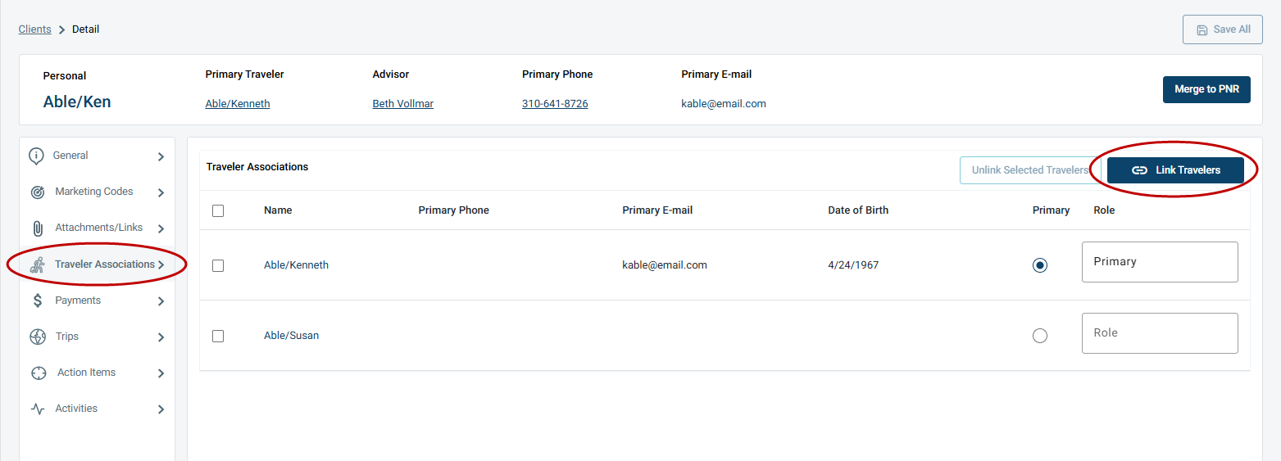
CBO Travelers in a Leisure Profile:
Tres Travelers in a Client Profile:
Related Articles:
Travelers
Linking Clients and Travelers

Slide 4
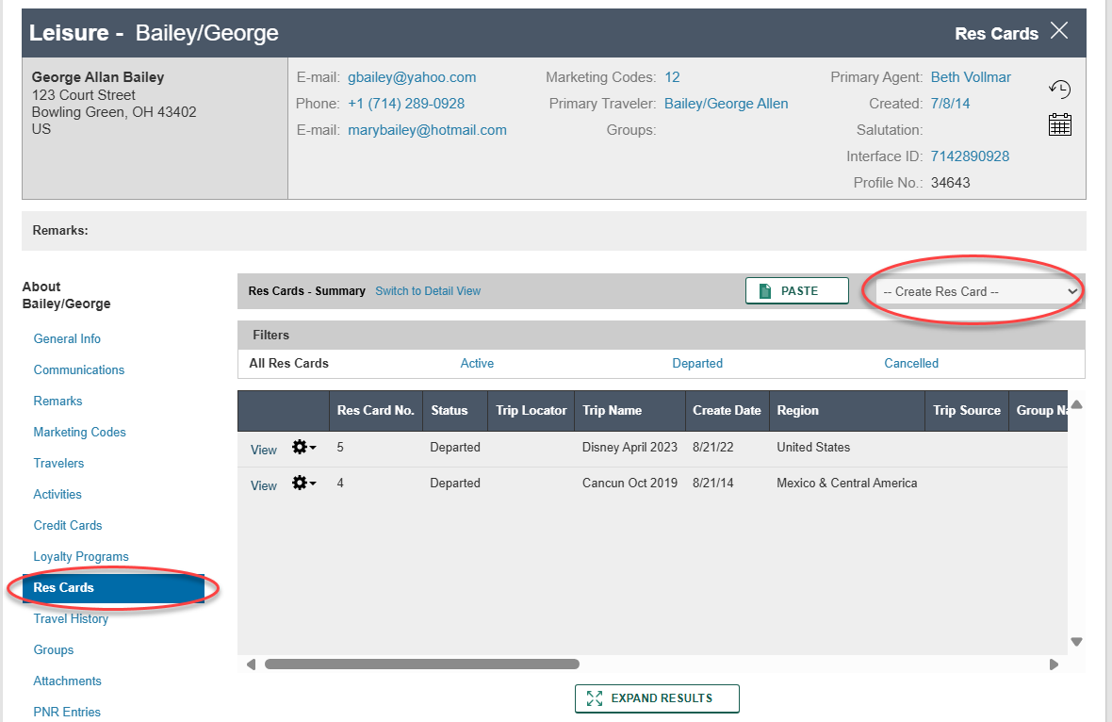
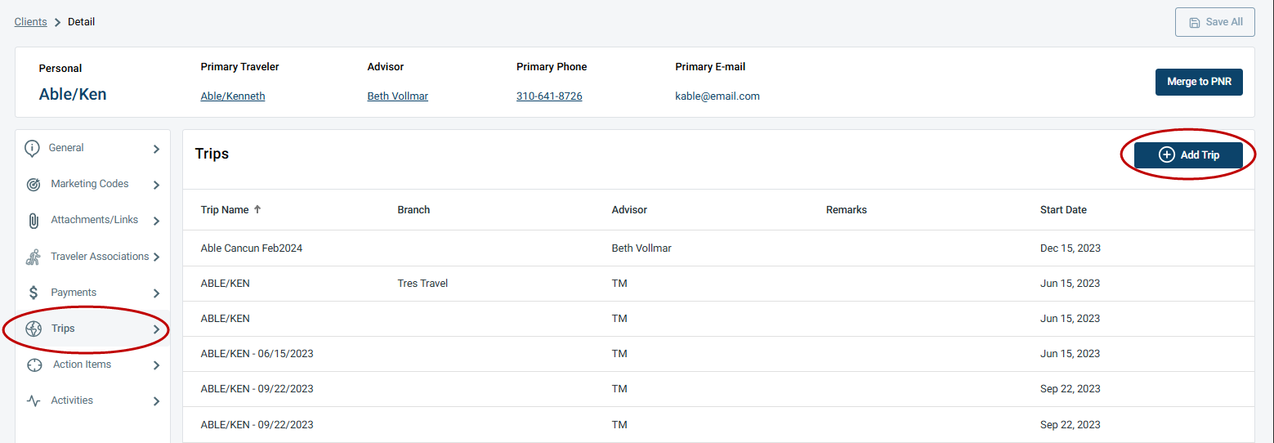
CBO Res Cards in a Leisure Profile:
Tres Trips in a Client Profile:
Related Articles:
Client Trips
Trips

Slide 5
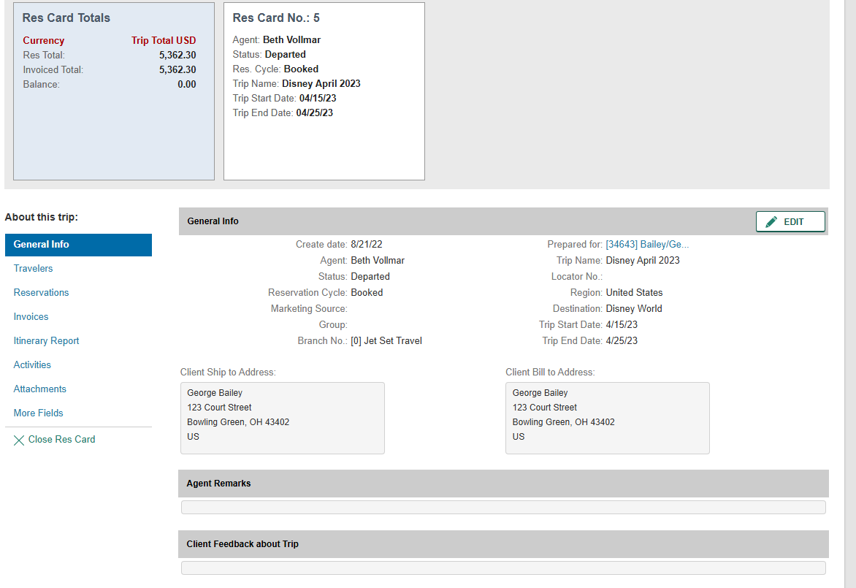
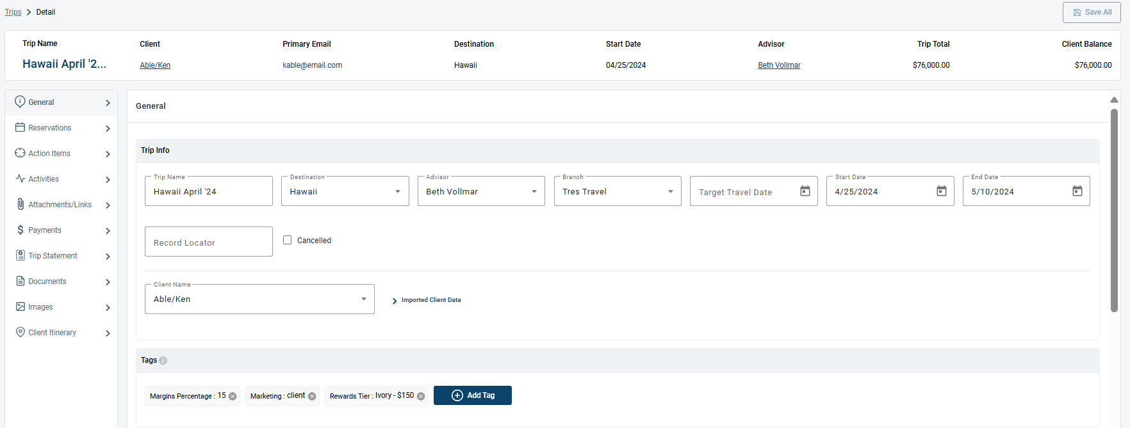
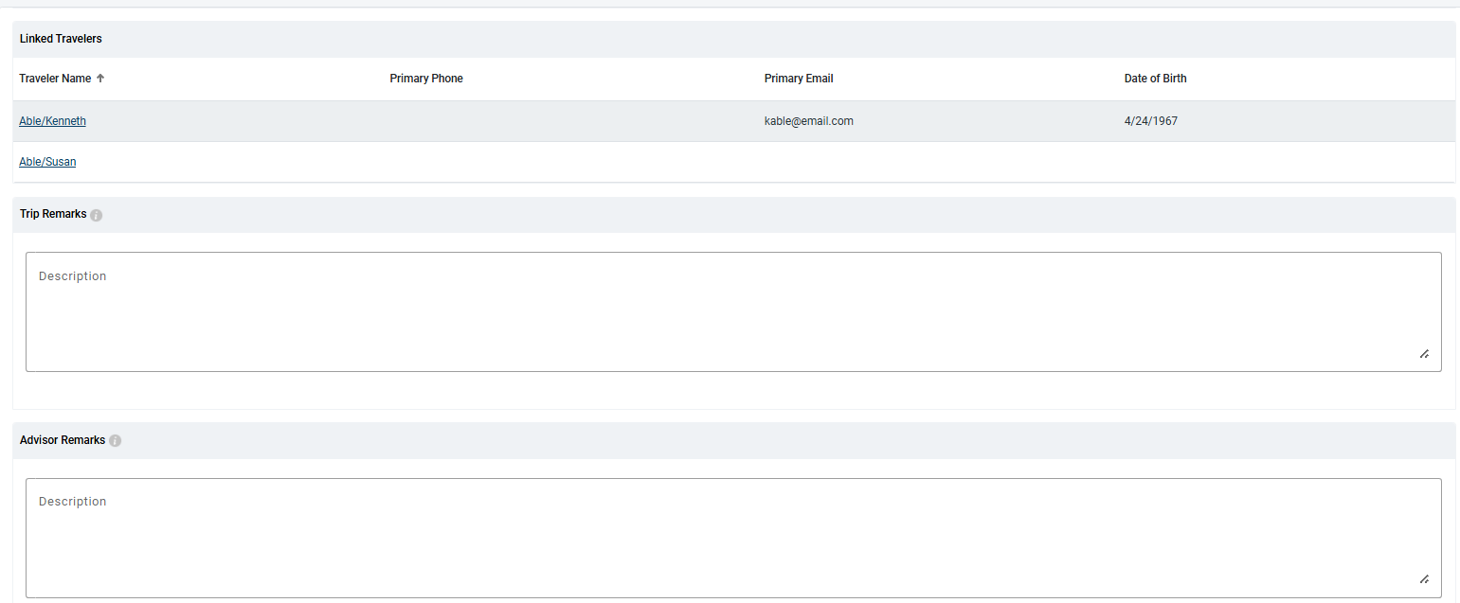
CBO Res Card:
Tres Trip:
Related Article:
Trips

Slide 6
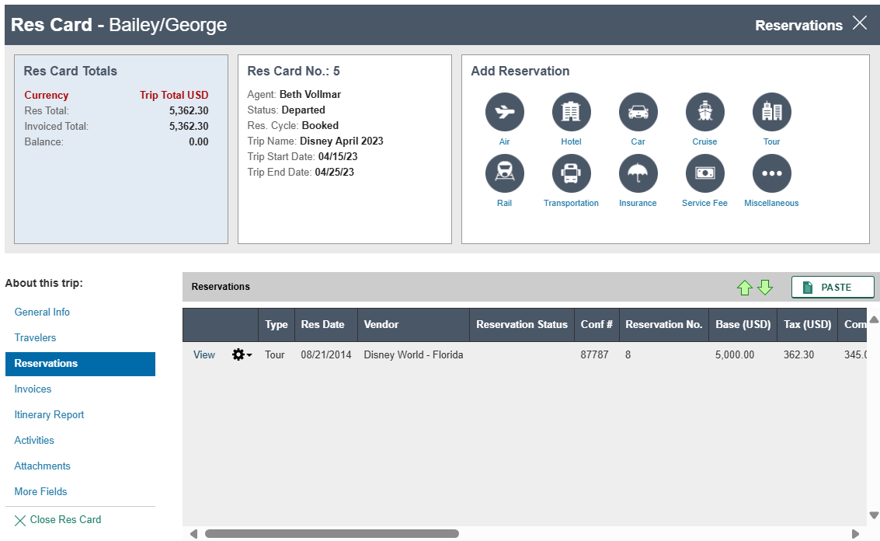
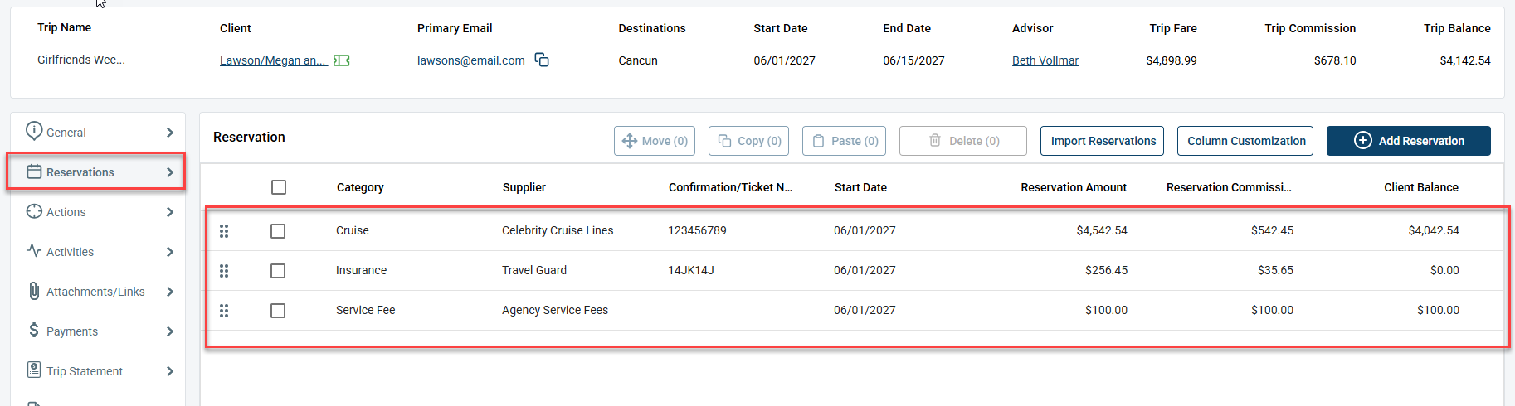
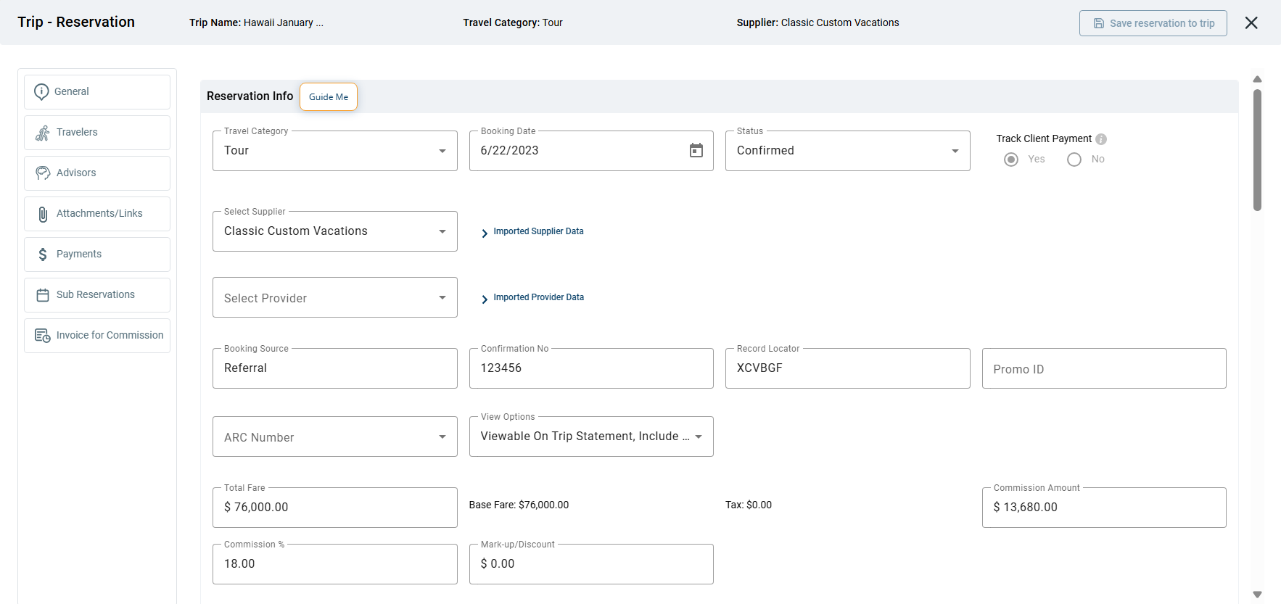
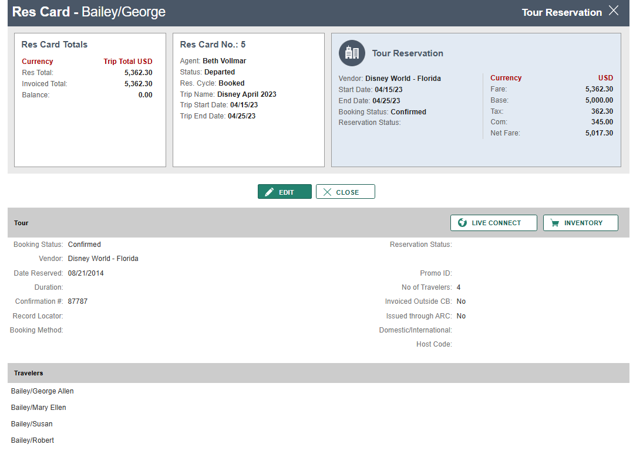
CBO Reservations:
Tres Reservations:
Related Article:
Reservations

Slide 7
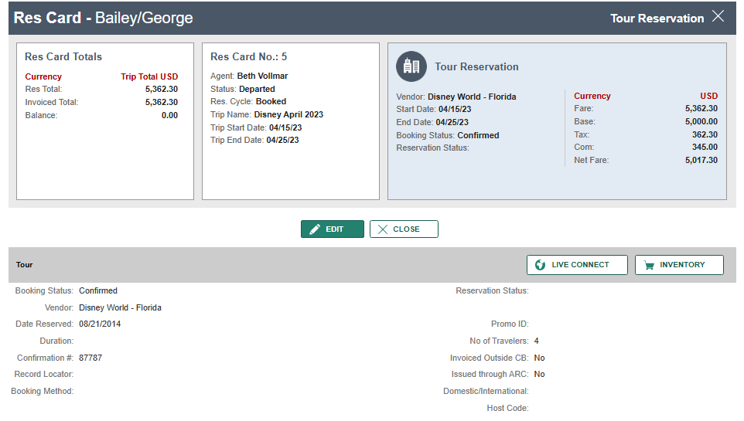
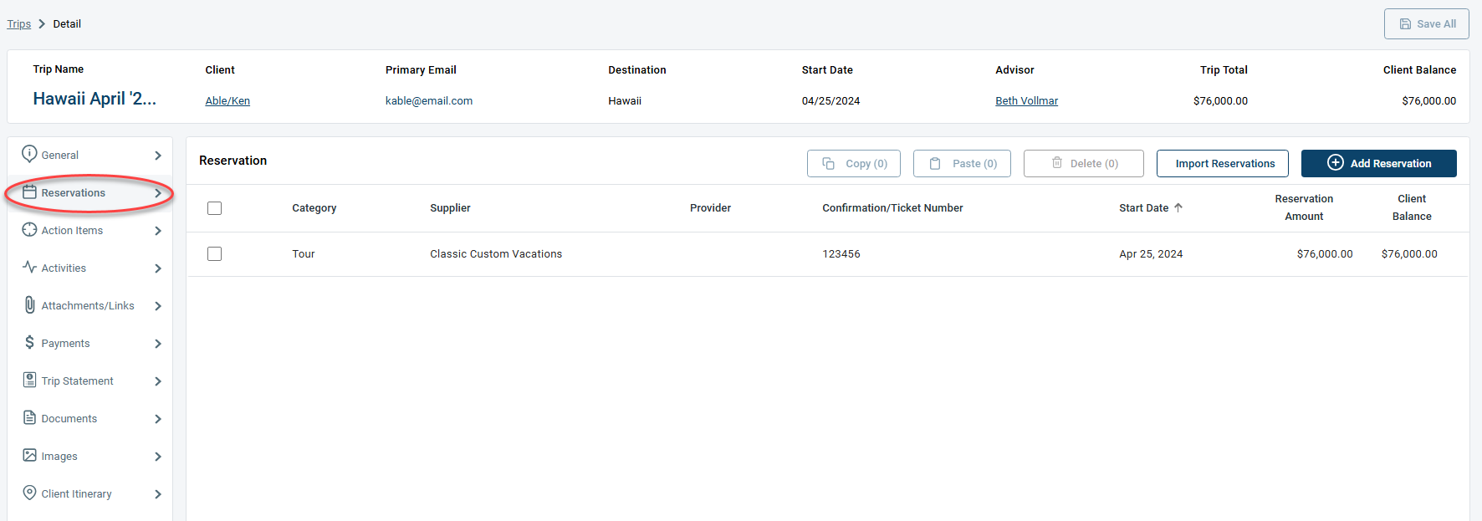
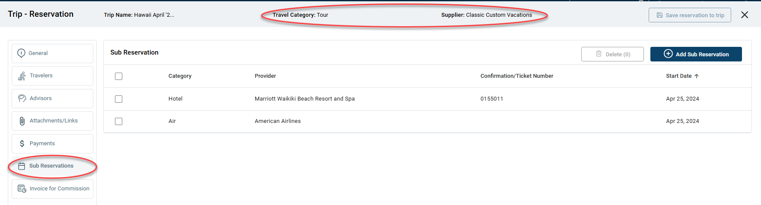
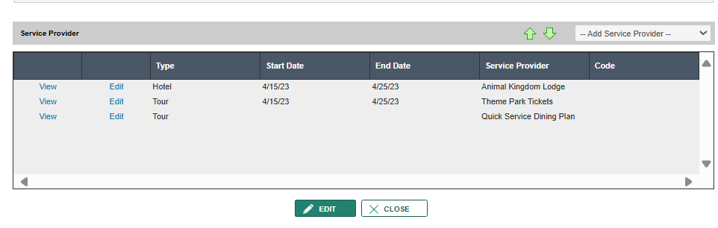
CBO Service Providers:
Tres Sub-Reservations:
Related Article:
Sub Reservations

Slide 8
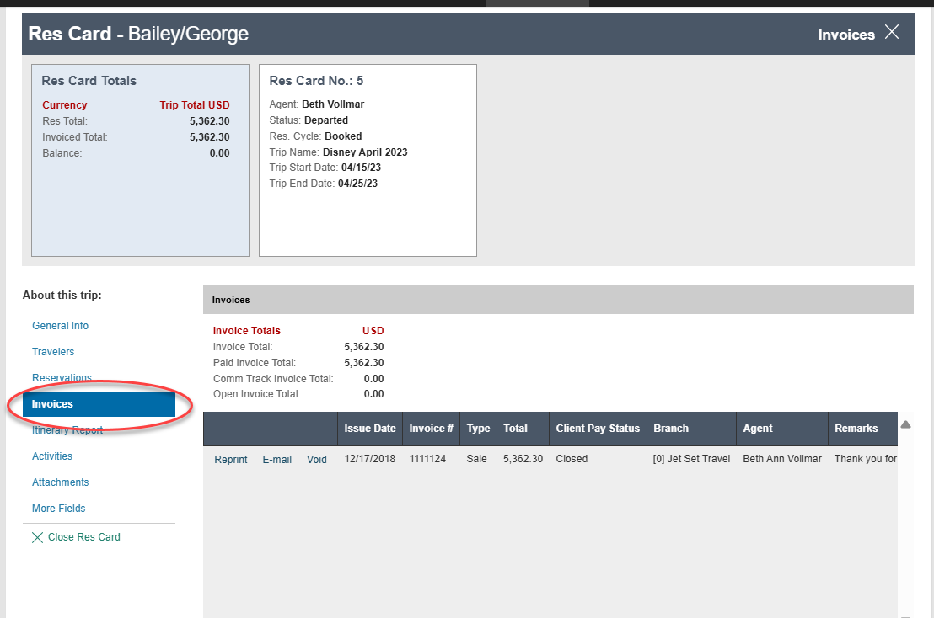
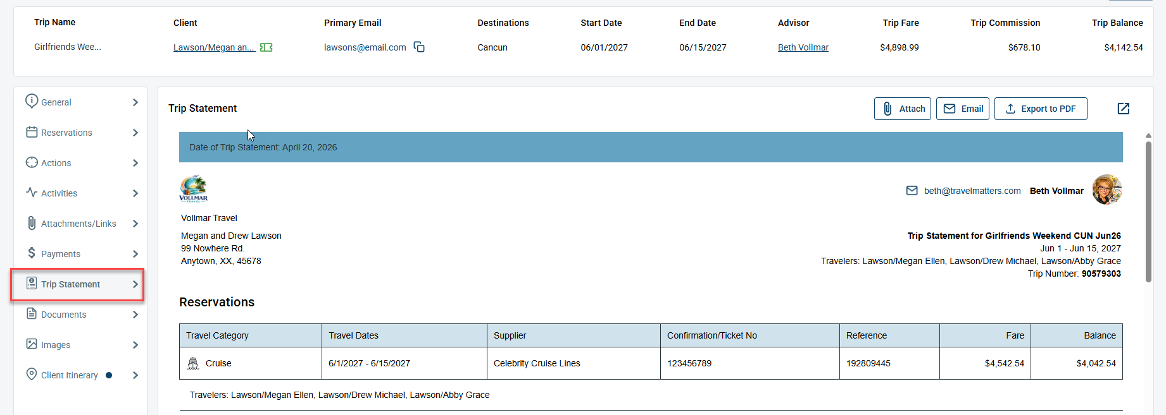
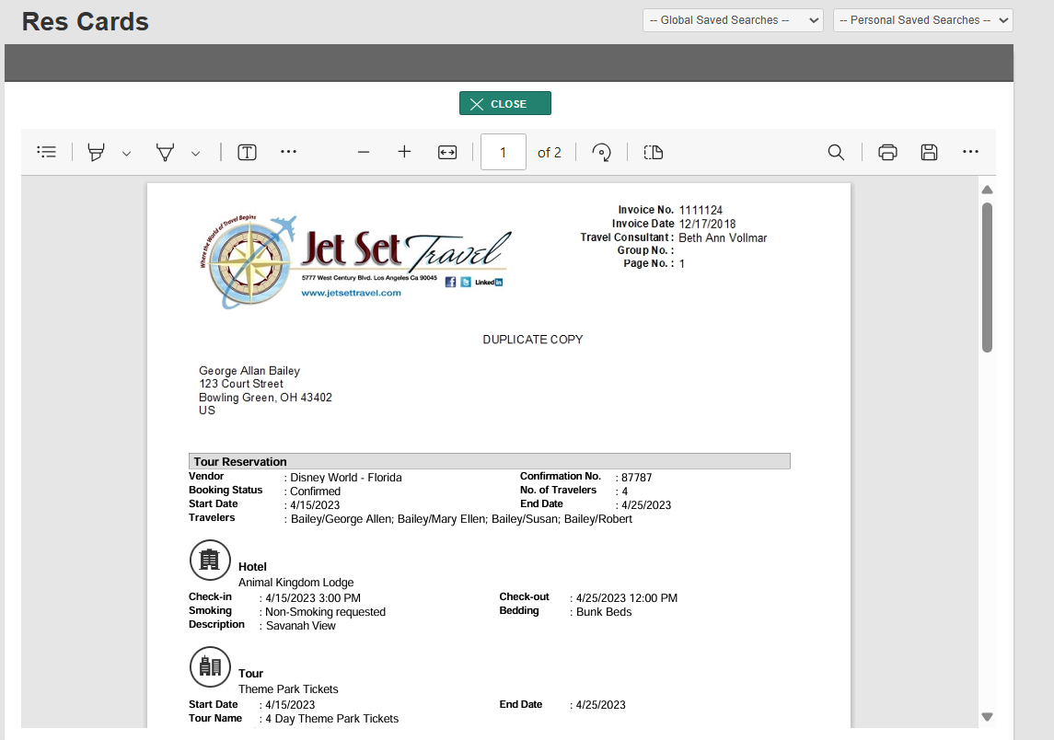
CBO Invoice:
Tres Trip Statement:
Related Article:
Trip Statement

Slide 9
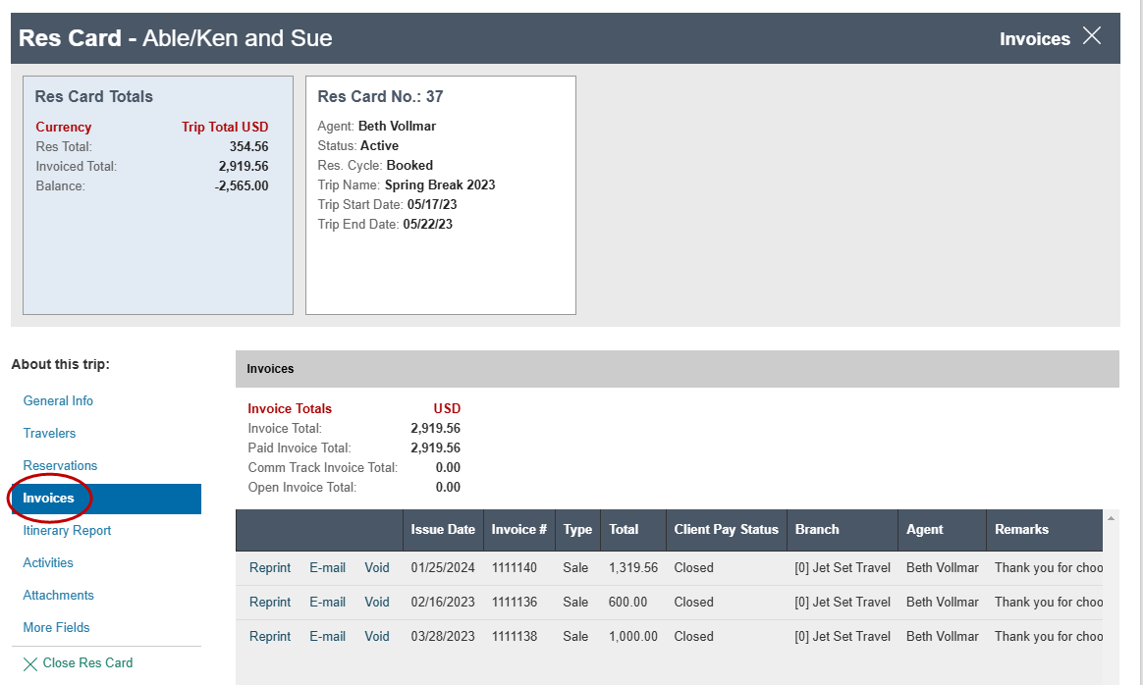
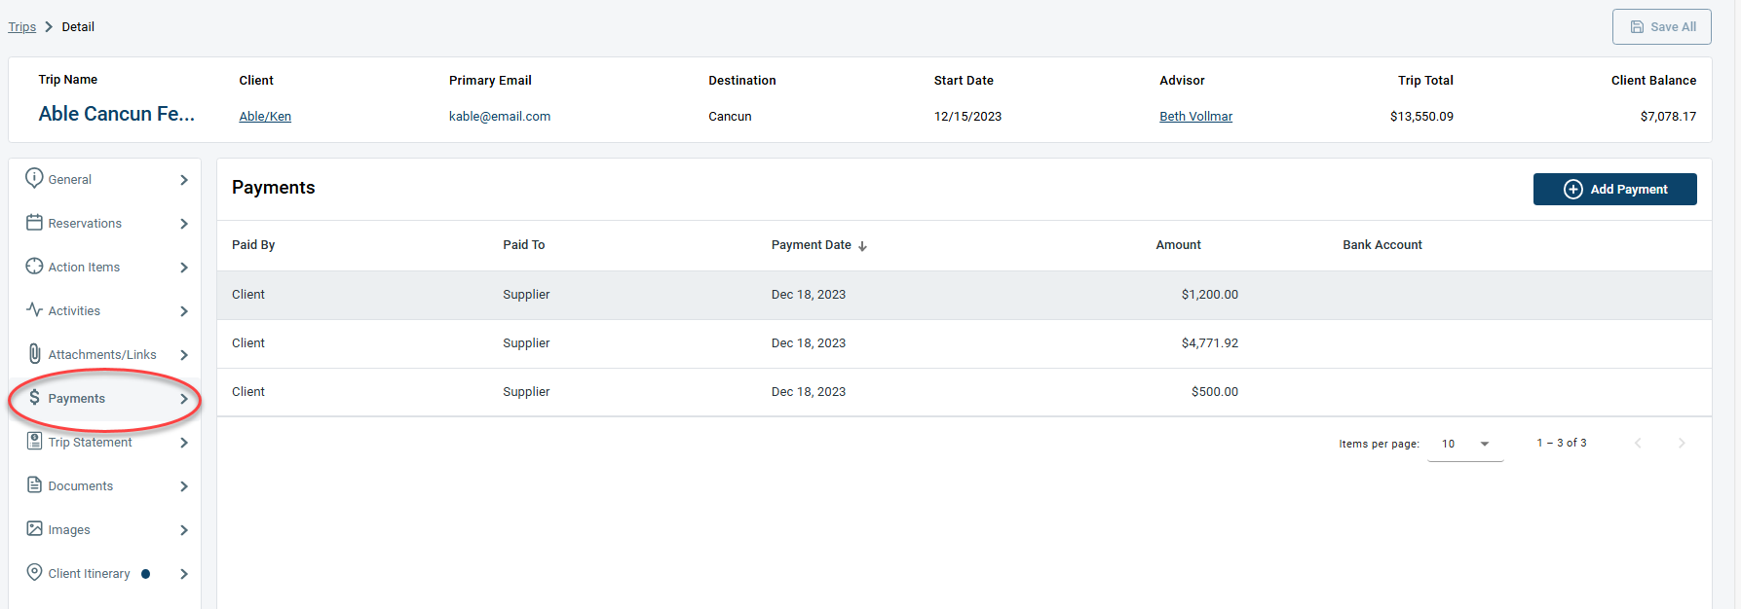
CBO Invoices in a Res Card:
Tres Payments in a Trip:
Related Article:
Trip Payments

Slide 10
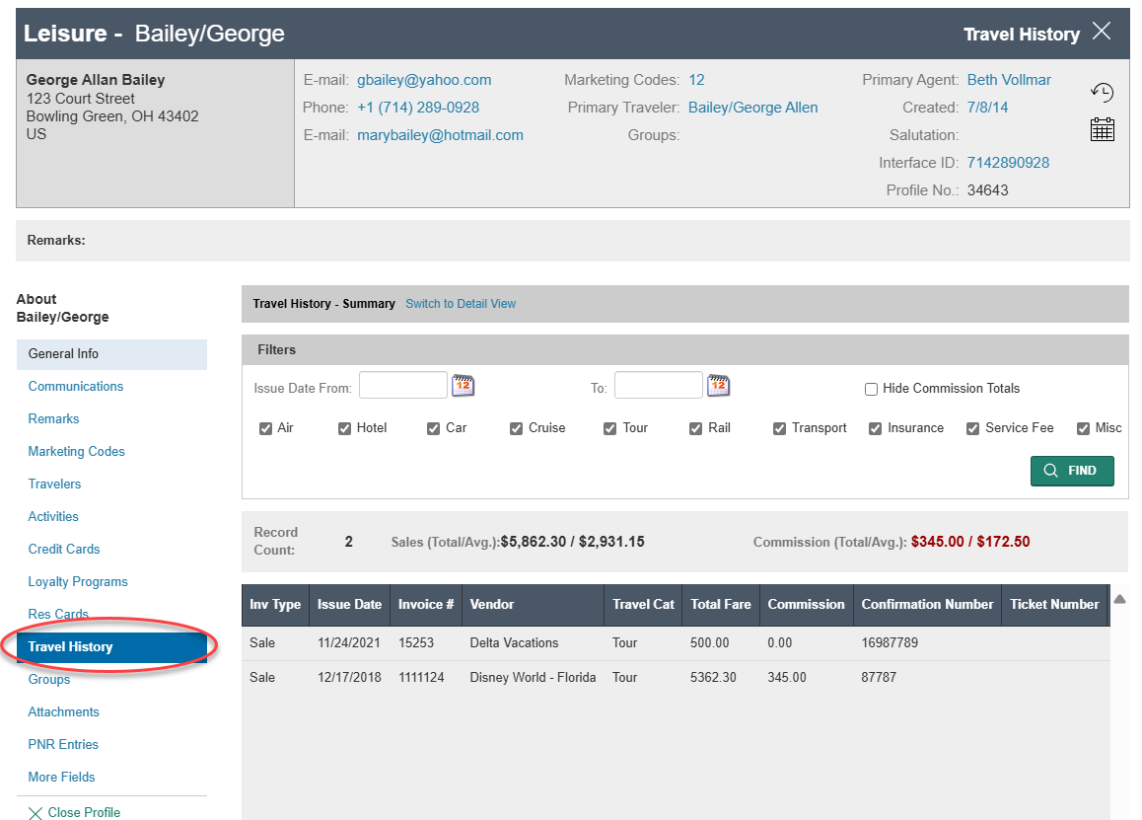
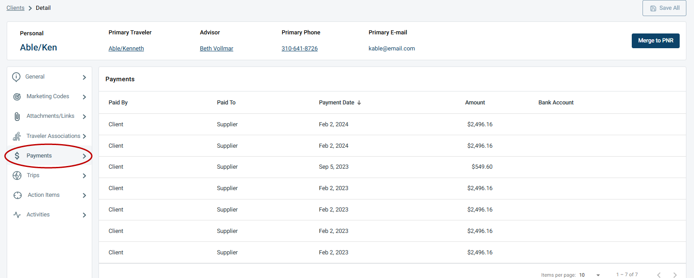
CBO Travel History in a Leisure Profile:
Tres Payments in a Client Profile:
Related Article:
Client Payments

Slide 11
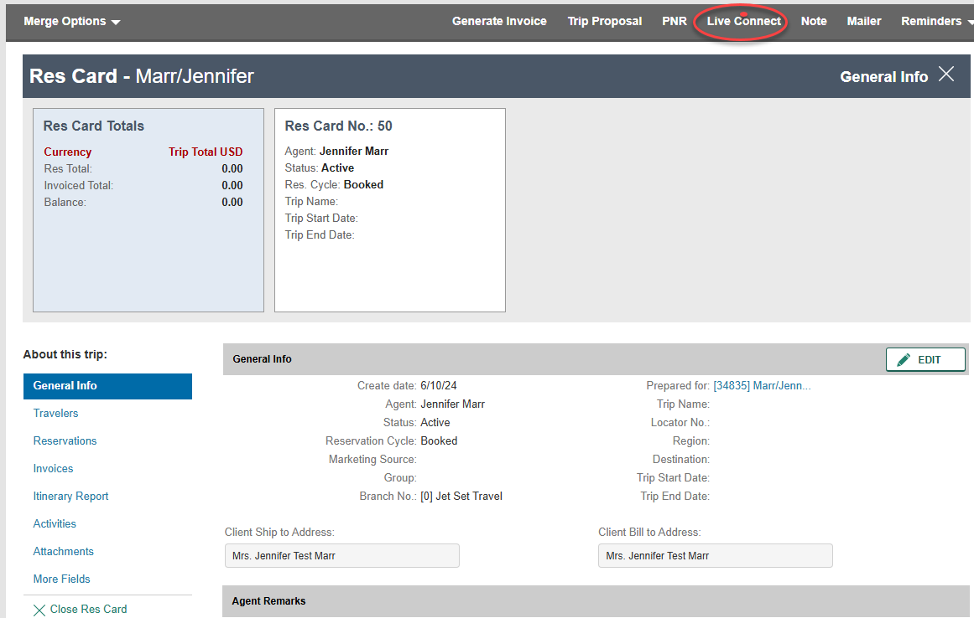
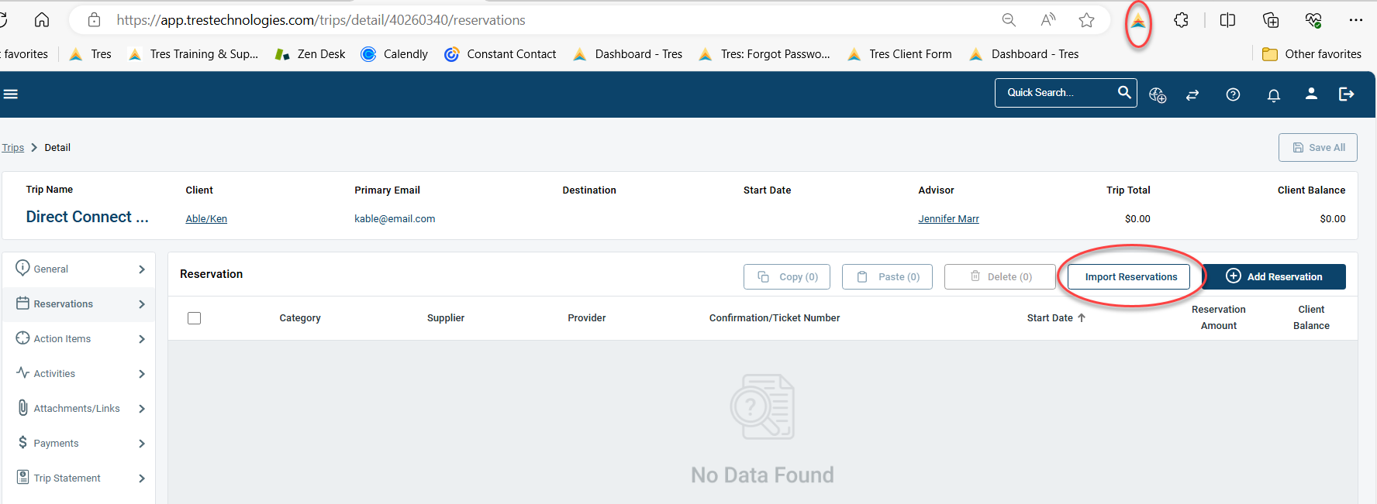
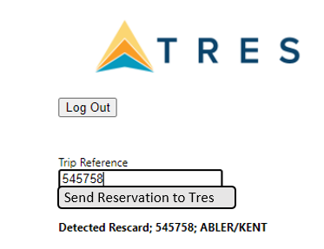
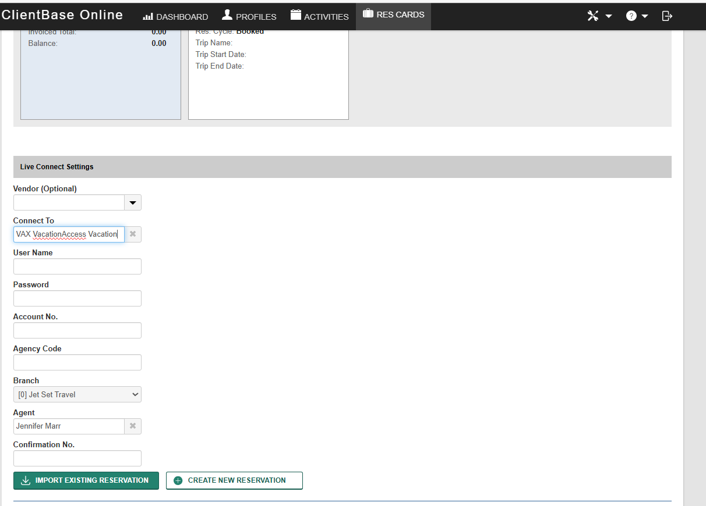
CBO Live Connect :
Tres Direct Connect:
Related Article:
Direct Connect

